Slide 1

E S S E N T I A L S
E D I T I O N
P R I V I L E G E D & C O N F I D E N T I A L
UNICORN DATA
ANALYSIS

Slide 2
AGENDA
01 Team
02 Purpose
03 Analysis
04 Recommendation

Slide 3
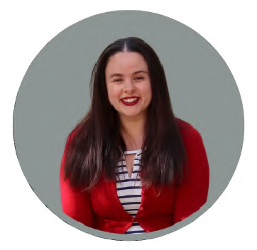

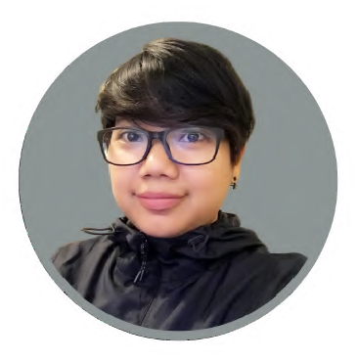

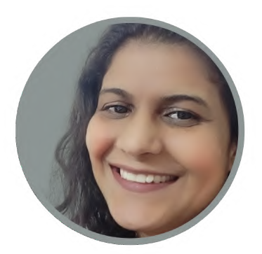
01 Team
These are the people at the heart and soul of your company. The multidisciplinary team fits the needs of your data analysis.
ASHLEY SELF
D A T A A N A L Y S T
N Y C, U S A
DEEPANSHU GUPTA
D A T A A N A L Y S T
N Y C, U S A
SENDY GOSAL
D A T A A N A L Y S T
N Y C, U S A
JOSEPH RODRIGUEZ
D A T A A N A L Y S T
N Y C, U S A
SAVITA DEVI
D A T A A N A L Y S T
N Y C, U S A

Slide 4
02 Purpose
How can Unicorn increase its profit margin over the next four quarters?

Slide 5
03 Analysis

Slide 6

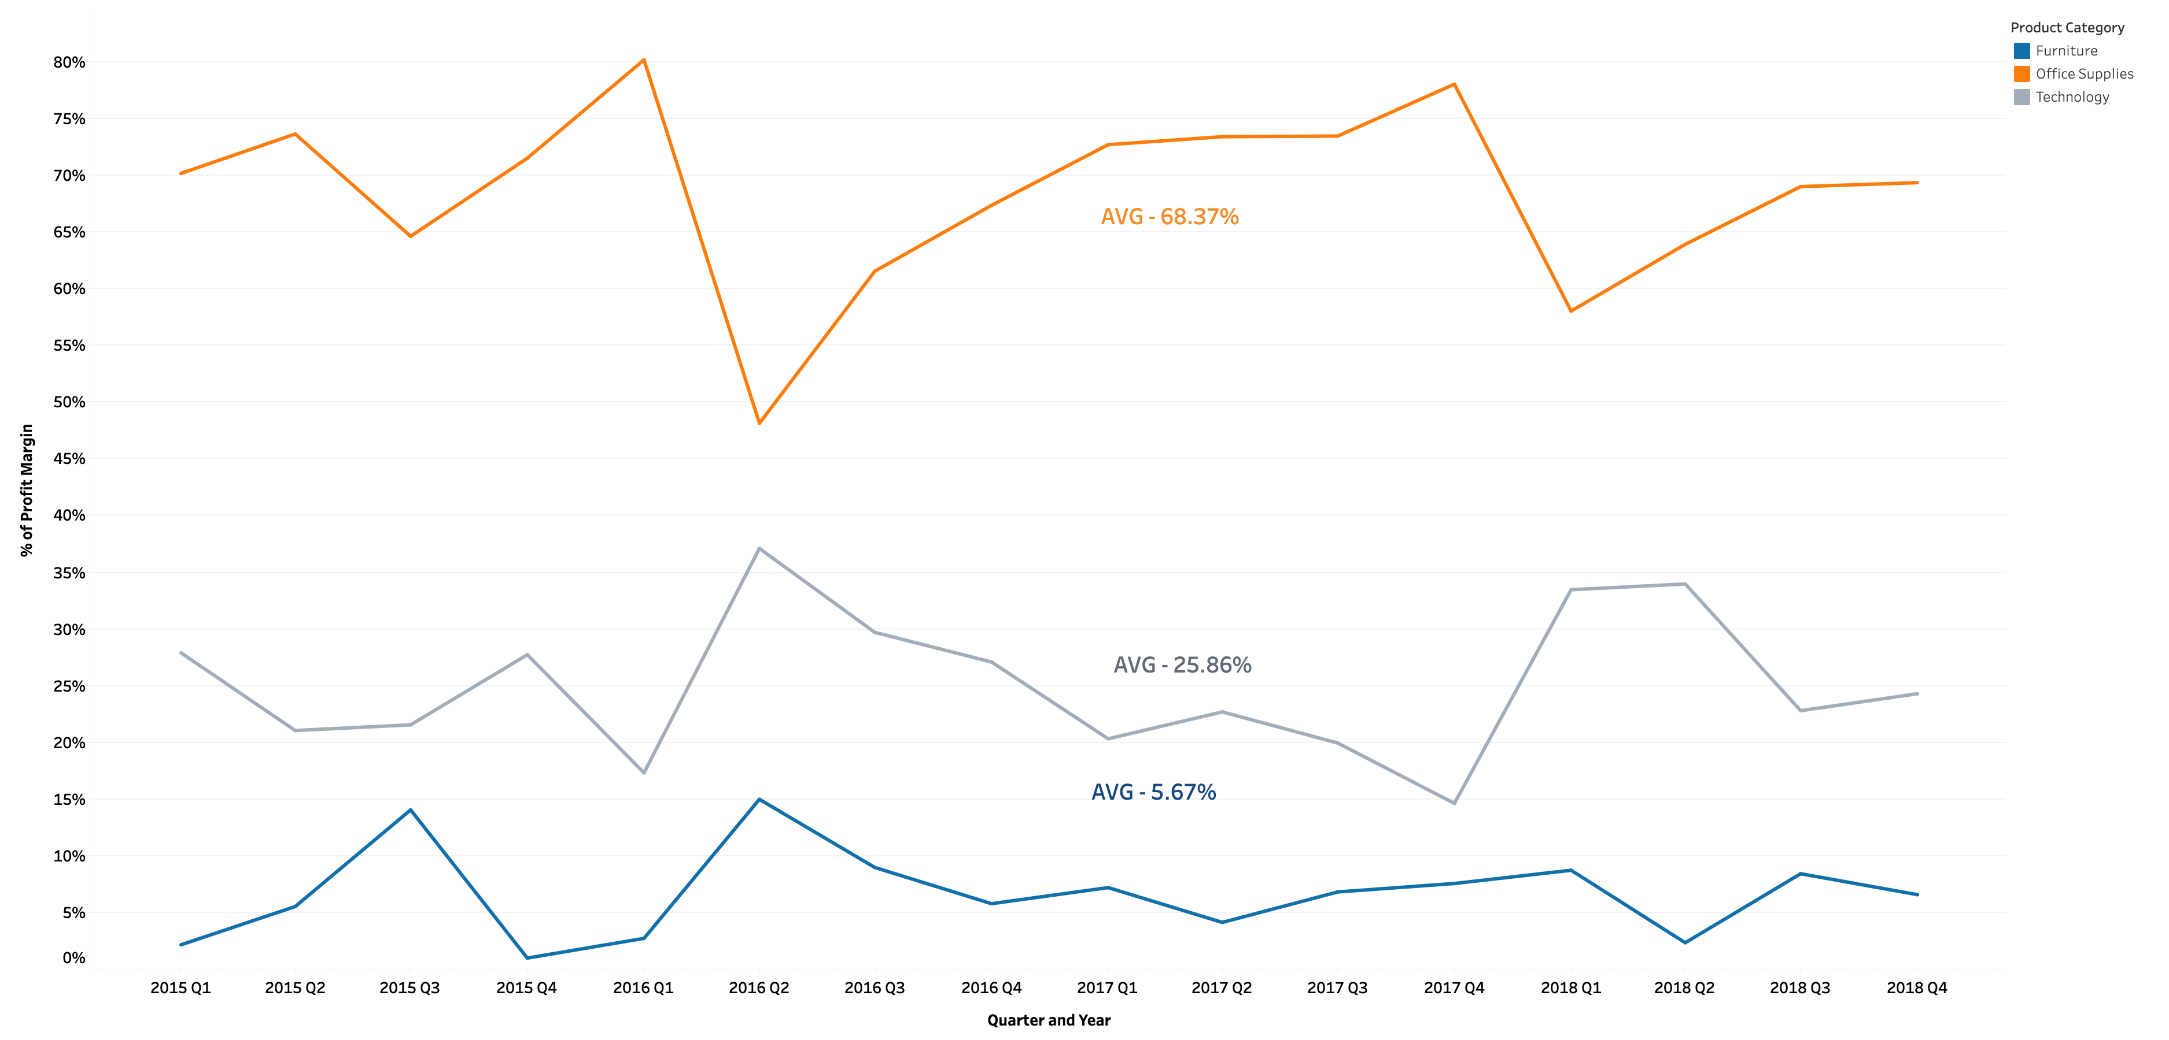
Profit Margin per product category over the last four years, broken down by quarter
ANALYSIS

Slide 7
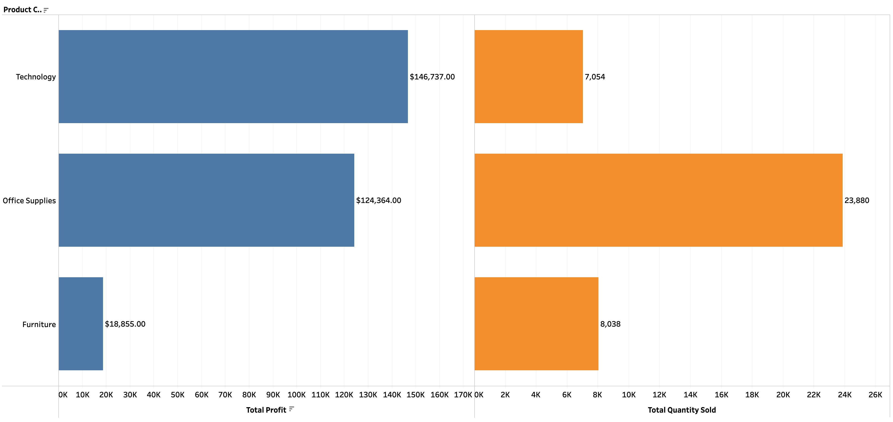
Total Historical Profit vs Total Quantity Sold per Category
ANALYSIS

Slide 8
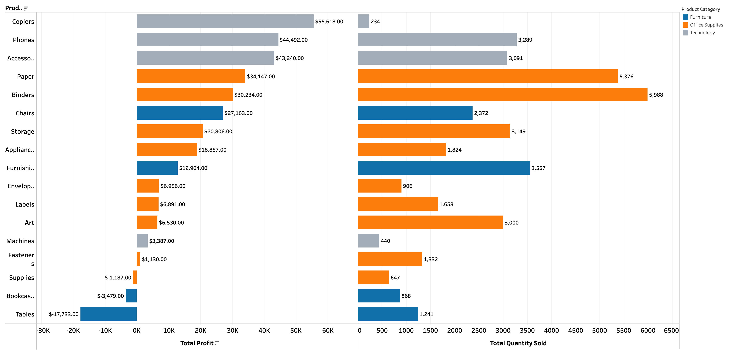
Overall Profit Vs Total Quantity in the Product Subcategories
ANALYSIS

Slide 9
04 Recommendation

Slide 10
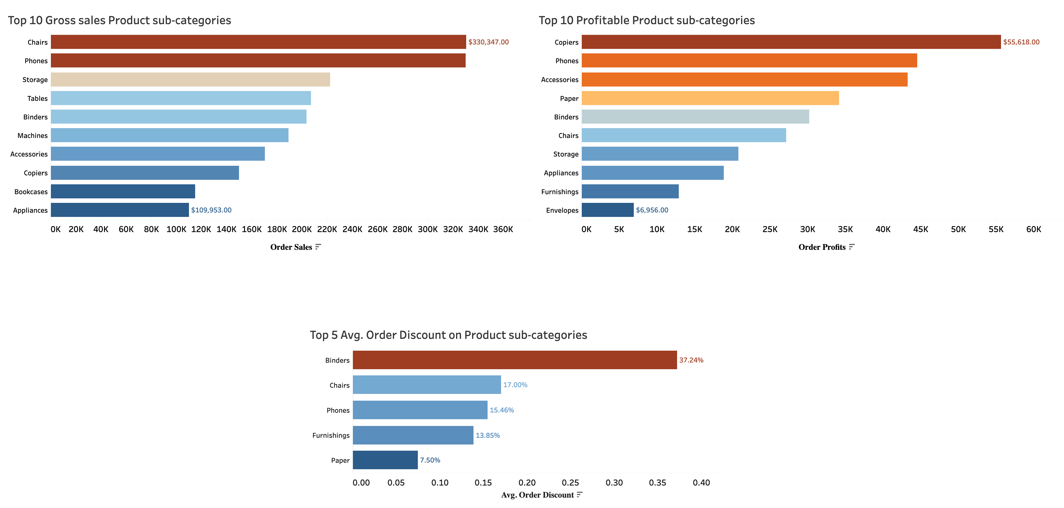
RECOMMENDATION
Overall sales
Chair $330,347
Phones $330,047
It is not much profitable compared to other products.
Discount
Chair 17%
Phones 15.5%

Slide 11
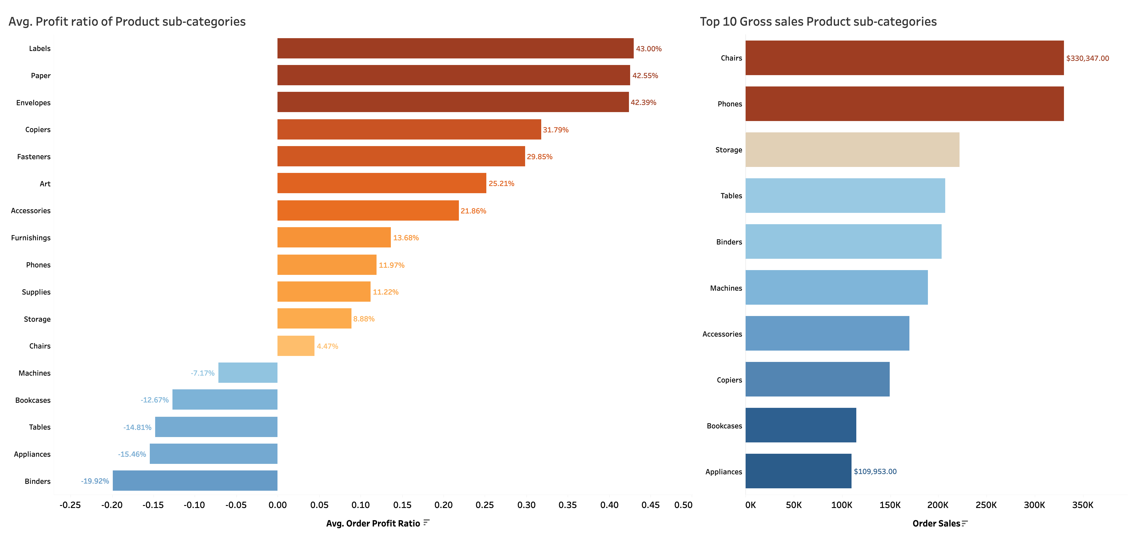
RECOMMENDATION
Overall Avg. Profit ratio
Phones 12%
Chairs 4.5%
Next goal: To increase profit of chairs and phones in the next four quarters
Recommendation: Test our hypothesis by doing A/B tests on our assumptions.

Slide 12
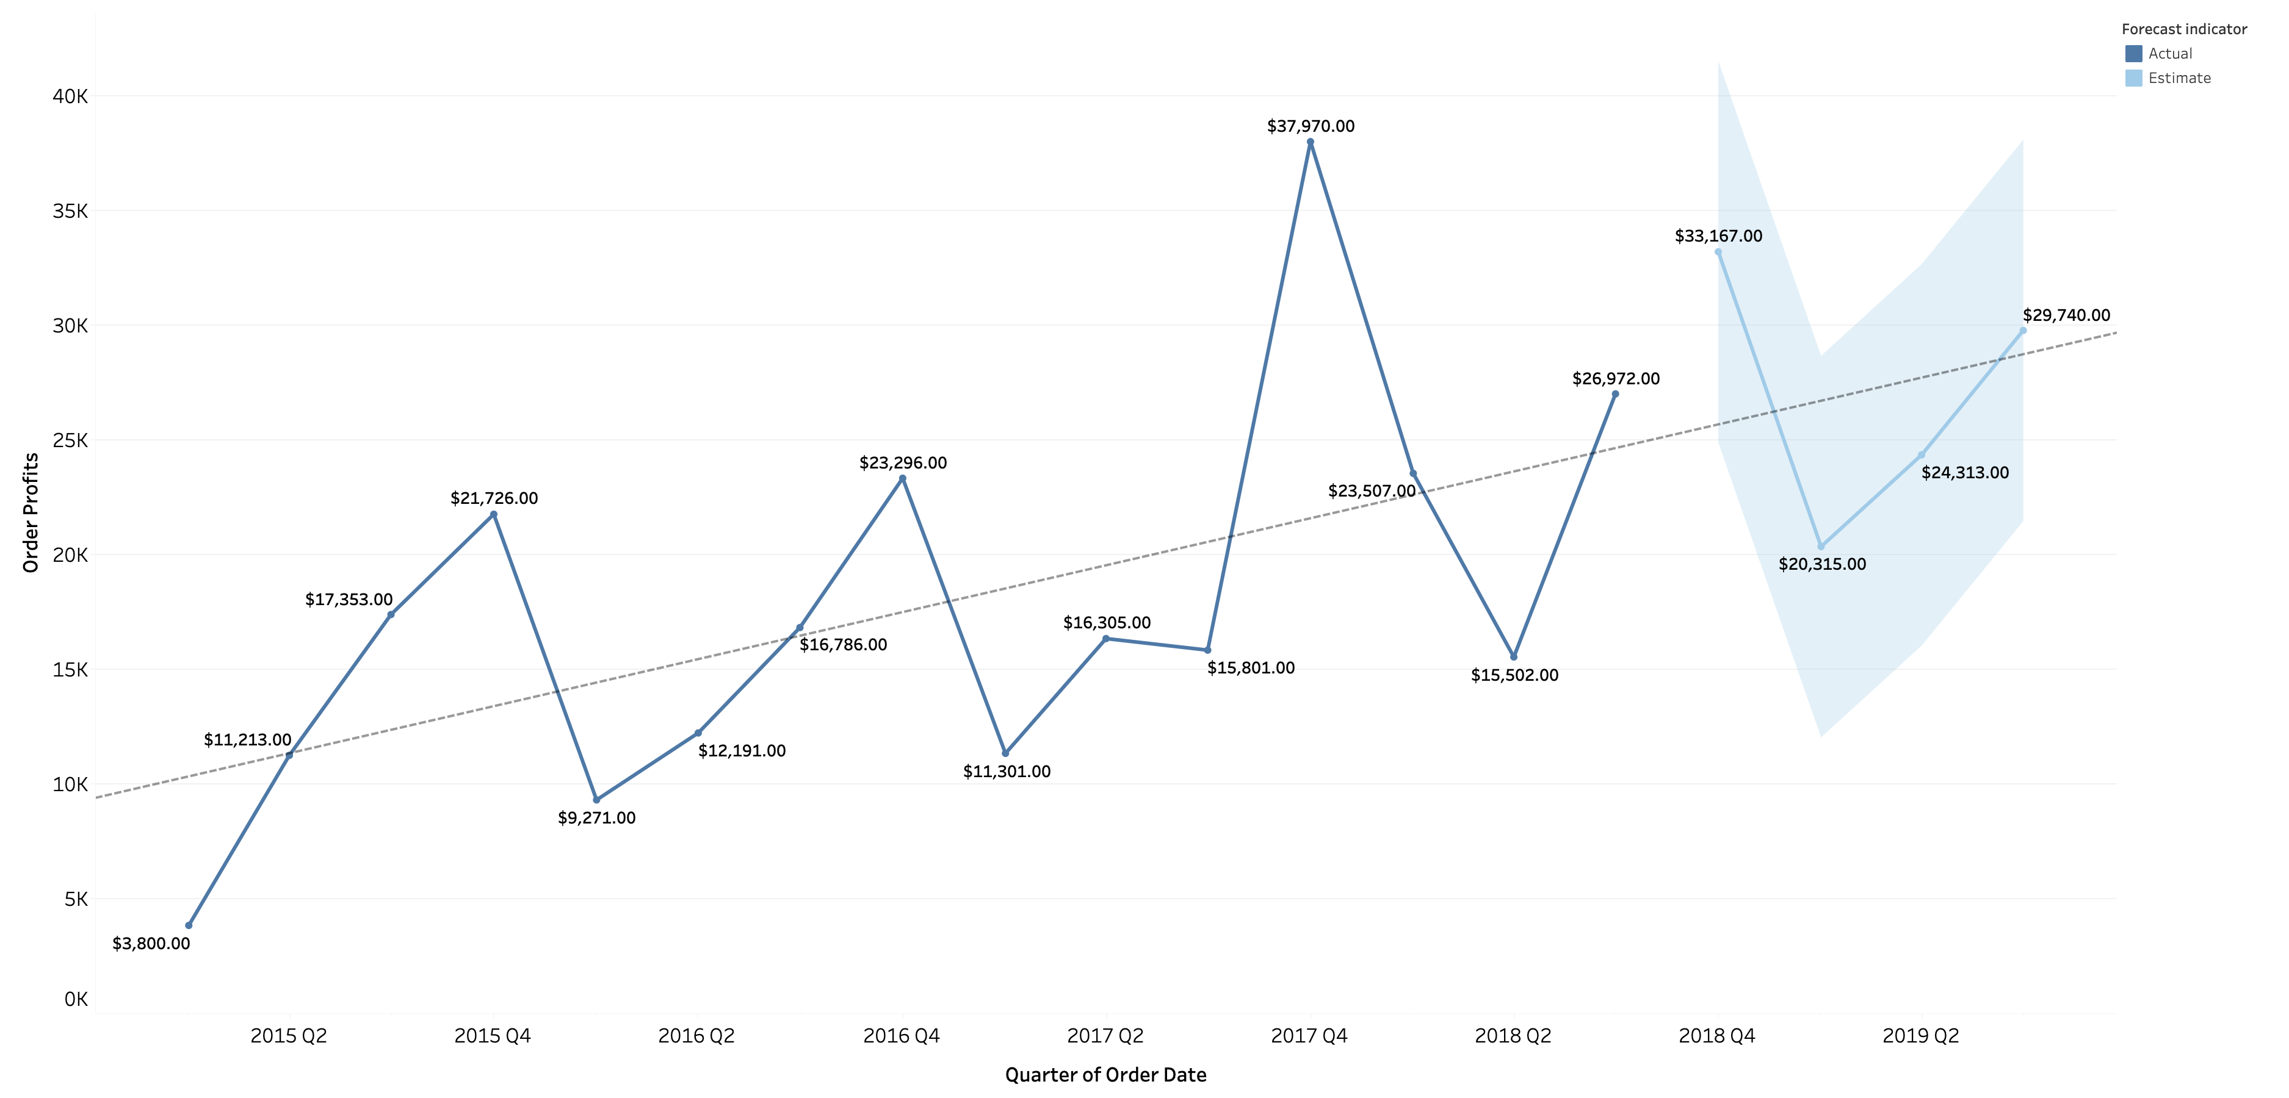
Historical Total Profits with a Positive Trend Line showing Potential Growth
P value: 0.0089
Confidence level: 99.11%

Slide 13
E S S E N T I A L S
E D I T I O N
P R I V I L E G E D & C O N F I D E N T I A L
THANK YOU
U N I C O R N

